Slide 1











JAEGER
An Open Source, Distributed Tracing Platform
PRESENTED BY
JEGAN BALAKRISHNAN

Slide 2
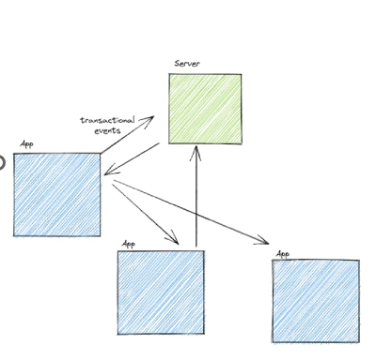
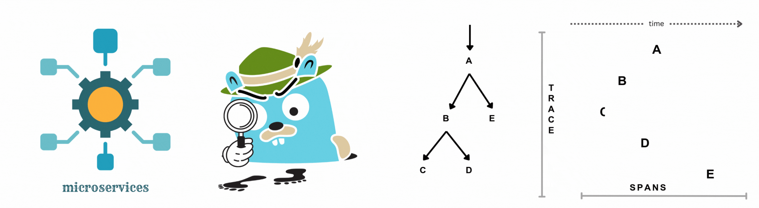
INTRODUCTION
JEGAN B
How Distributed Tracing works?
Jaeger

Slide 3

INTRODUCTION
JEGAN B
How Distributed Tracing works?

Slide 4
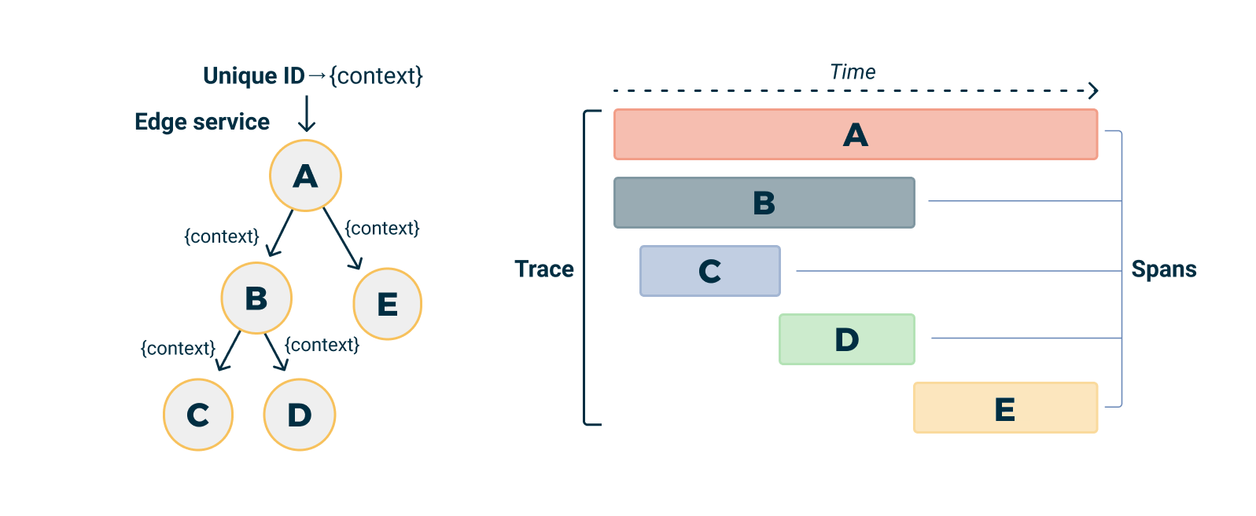

JAEGER
INTRODUCTION
Jaeger is a distributed tracing platform released as open source by Uber Technologies in 2016.
Donated to Cloud Native Computing
Foundation

Slide 5

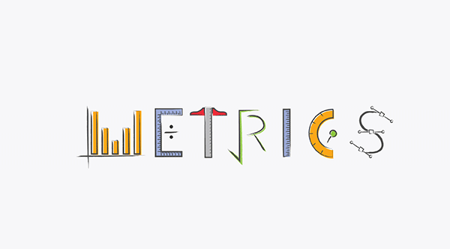



JAEGER OFFERS
Metrics
Identify
Bottlenecks
Integration
Visualization
Monitoring Traces

Slide 6




UNDERSTANDING WITH EXAMPLE
RESTAURANT
SOIL NUTRIENT
DETECTION SYSTEM
Customer
Waiter
Kitchen
Dish Washing

Slide 7
UNDERSTANDING WITH EXAMPLE
RESTAURANT
If any problem occurs in the middle, who will be reason?
SOIL NUTRIENT
DETECTION SYSTEM
Customer
Waiter
Kitchen
Dish Washing

Slide 8
UNDERSTANDING WITH EXAMPLE
RESTAURANT
Jagger traces each and every steps including the period of time.
Helps to find where the delay or problem happened!
SOIL NUTRIENT
DETECTION SYSTEM
Customer
Waiter
Kitchen
Kitchen
Dish Washing

Slide 9
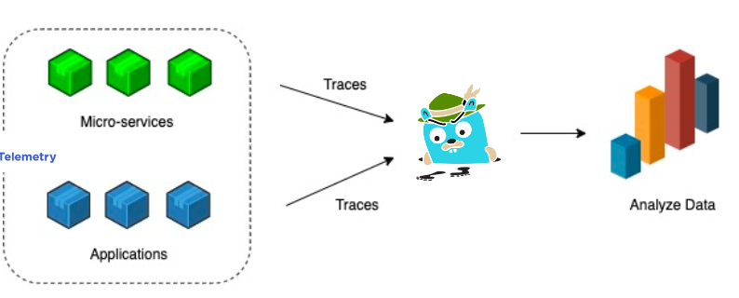
JAEGER

Slide 10
JAEGER
SPANS AND TRACES

Slide 11






JAEGER
SPANS AND TRACES
Collection of spans that
collectively illustrate the
journey of a request
SPAN 1
SPAN 2
TRACE 1
SPAN 3
Represents a unit of work in our system

Slide 12
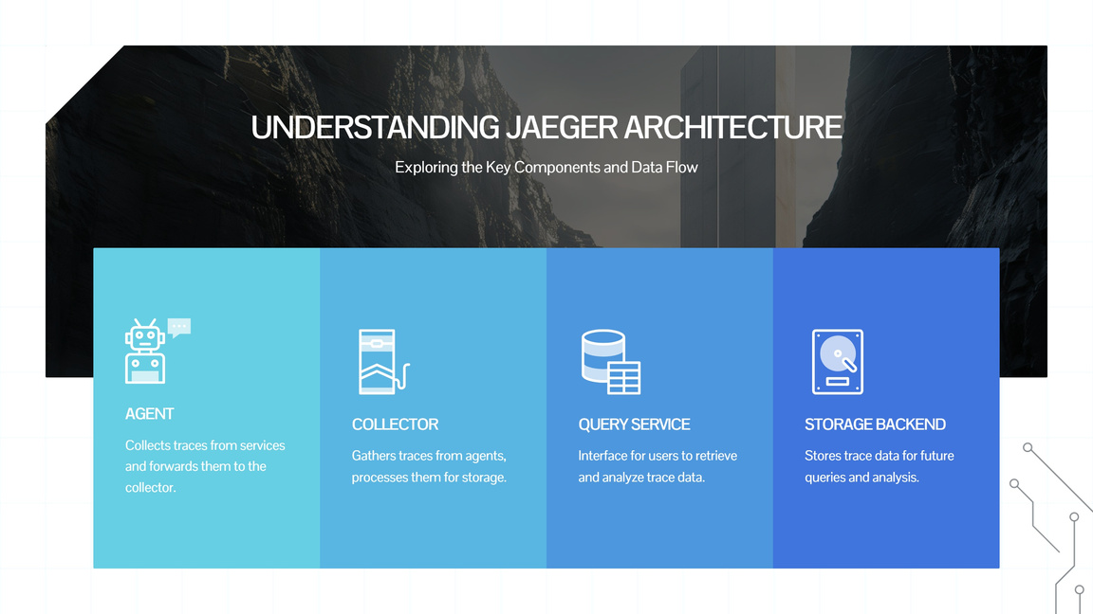

Slide 13
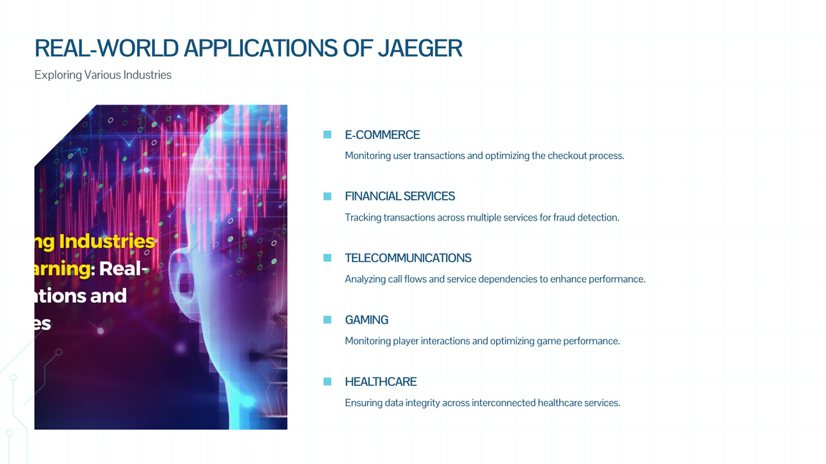

Slide 14
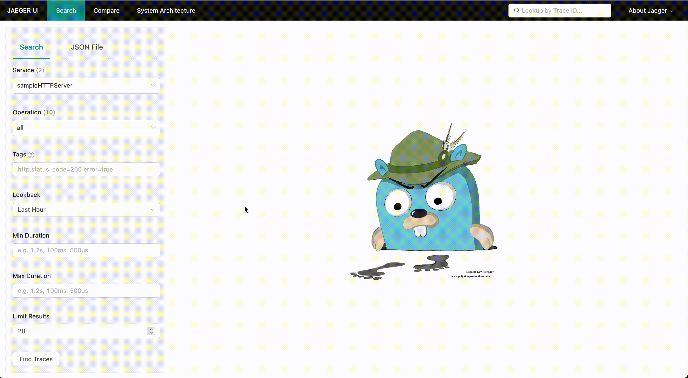
DEMO

Slide 15
THANKYOU!

